Slide 1
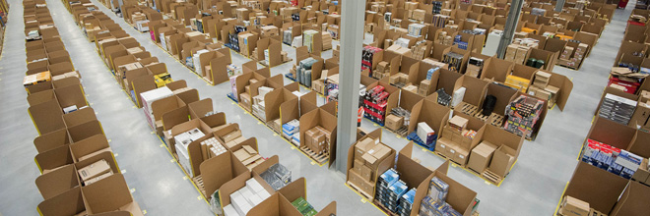

TOPIC – DASHBOARD ON TOY SALES DATA
SUBMITTED TO :- FunctionUp
SUBMITTED BY :- Yash Jadon
Roll Number :- fn-may-39LZR

Slide 2
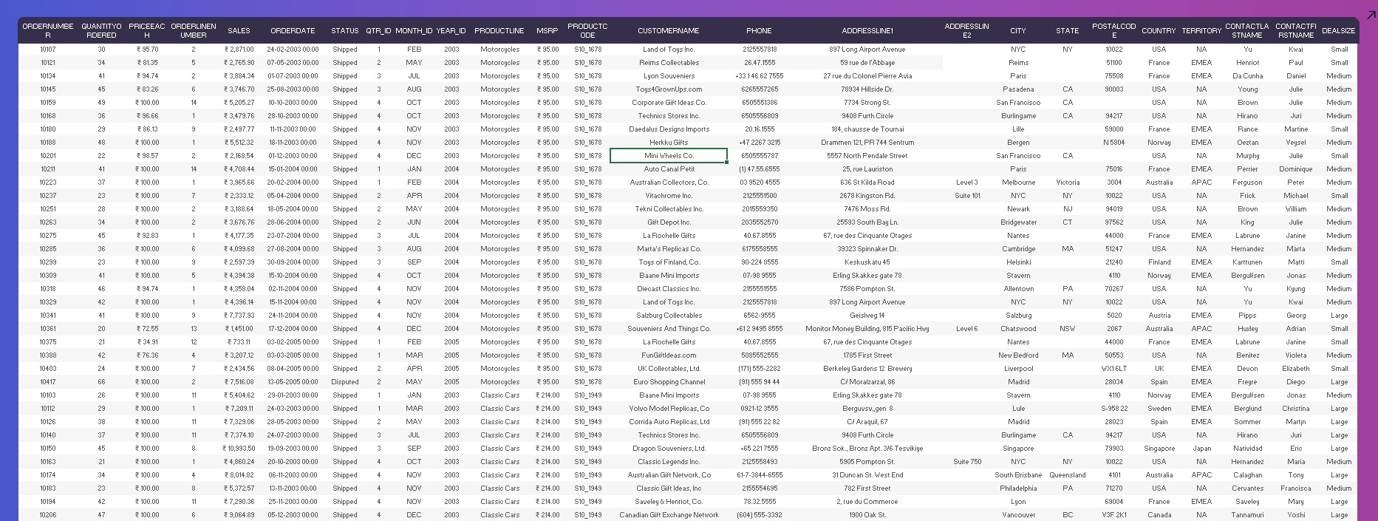

Slide 3

KEY COLOUMNS IN DATASET
QUANTITY ORDERED
PRICE OF EACH ARTICLE
SALES
ORDER DATE
STATUS OF SHIPMENT
TERRITORY, COUNTRY, STATE, CITY
DEAL SIZE

Slide 4

INSIGHTS
Monthly sales
Top 10 Products generating the highest revenue
Top 5 products which are being sold the most in quantity
Territory with highest sales
Top 10 countries by highest sales
territory wise distribution of deal size
Distribution of order status by region
Average token price
Highest seller and Lowest seller

Slide 5
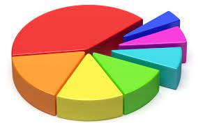
MAJOR KPI’S
Highest selling product
Region with highest sales
Country with highest revenue
Yearly sales growth
Monthly growth

Slide 6
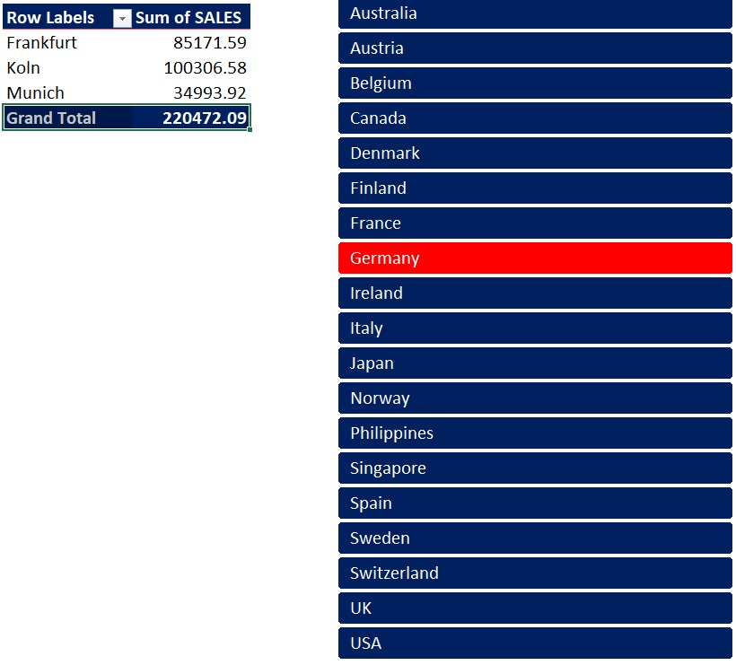
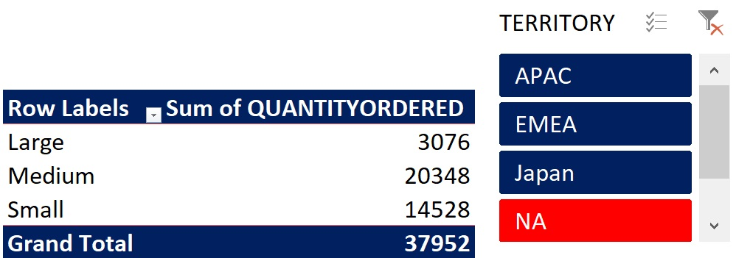
PIVOT TABLE USED
Territory wise distribution of deal size
Region wise sale

Slide 7
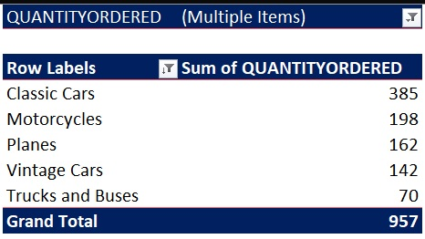
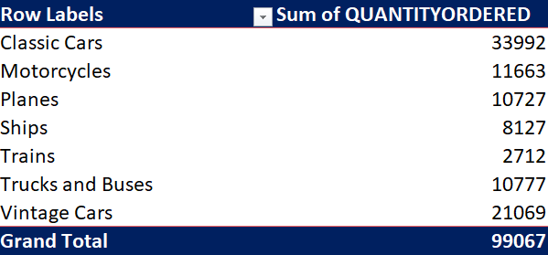
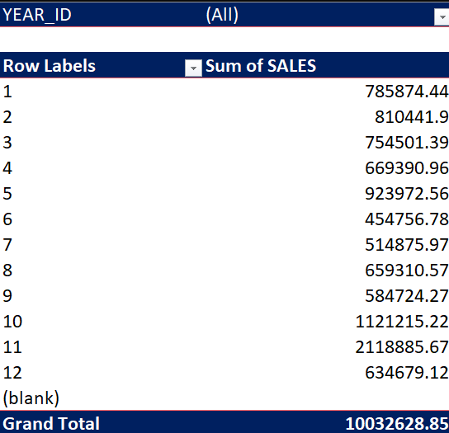

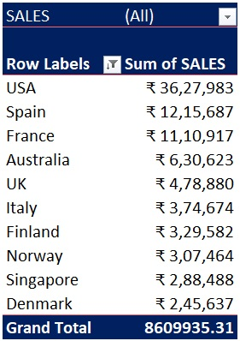
Top 5 Most sold products
Products with revenue
Territory with highest sales
Top 10 countries with highest sales
Monthly sales

Slide 8
CHART USED
Doughnut Chart
3D Stacked Column
Clustered Bar
Line with markers
Combination of Stacked Area and Clustered Column
Combination of line with markers and Area

Slide 9
THANK YOU
END OF PRESENTATION

